Slide 1
liveability
Yr 7 Geography

Slide 2
Liveability
List as many reasons why you live where you do in 60 seconds.
Why do you live where you do?
Progress Bar
Timer – 60 Seconds!

Slide 3

Unit objectives
Our goal for this unit of work to be able to answer the following questions:
1. What factors influence people’s decision on where they live?
2. Why do you enjoy or not enjoy where you live?
3. How is the liveability of places measured?
4. How do the liveability factors of climate, environmental quality,
infrastructure, safety and stability and access to health care and education
impact people around the world?
5. What factors do planners of new developments have to consider?

Slide 4

Lesson objectives
Learning Intentions
Understand the concept of liveability and why we live where we do.
Success Criteria
Define liveability
List factors that influence liveability

Slide 5


brainstorm
What I like about where I live?
What I dislike about where I live?

Slide 6
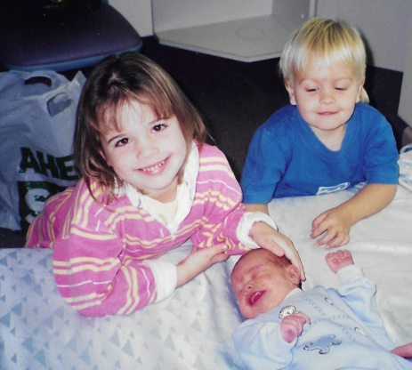
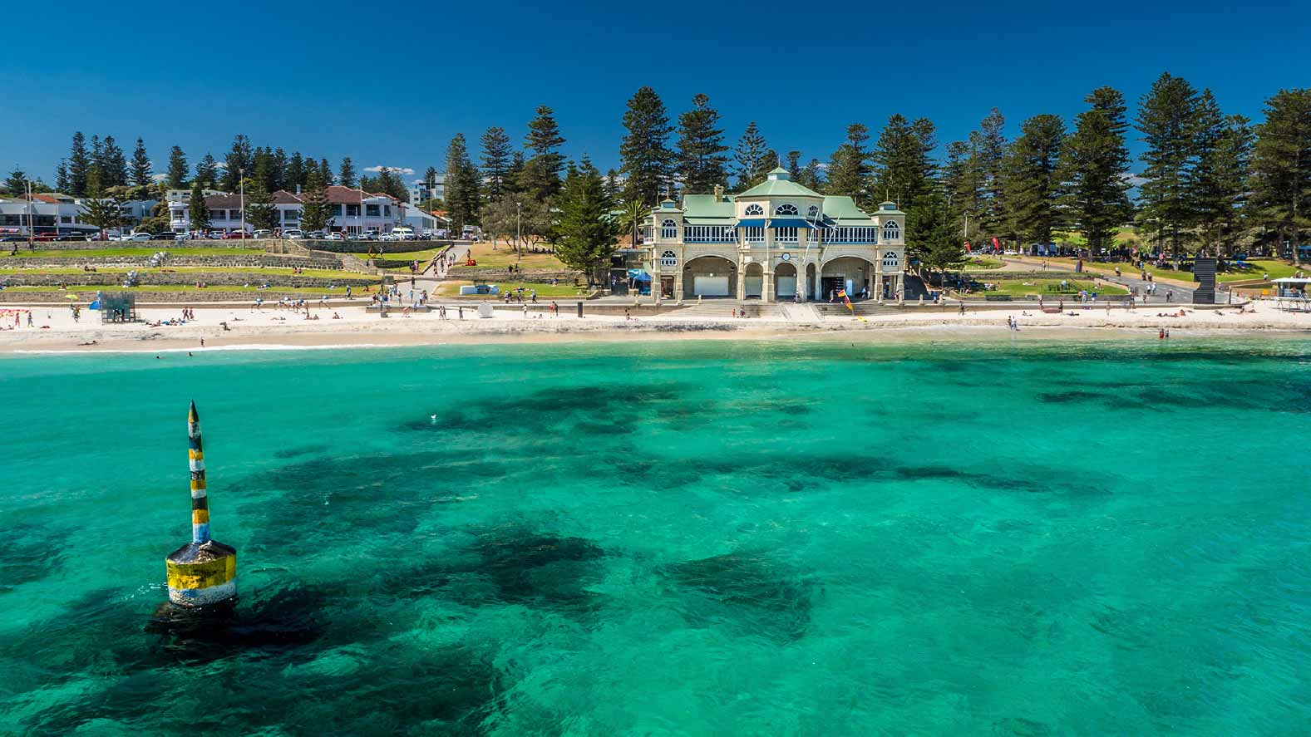
1. Attachment to place

Slide 7

2. Distance from family and friends

Slide 8
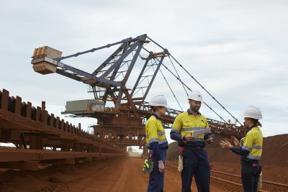
3. Employment opportunities

Slide 9
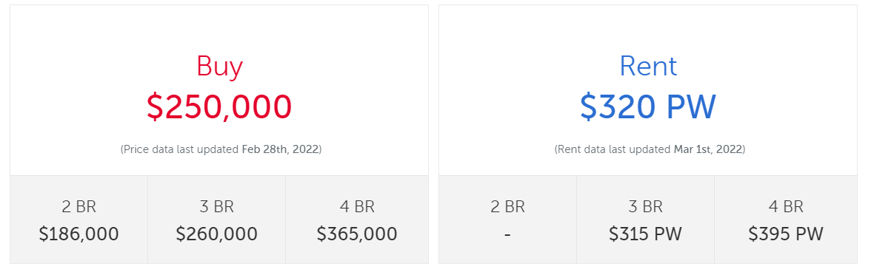
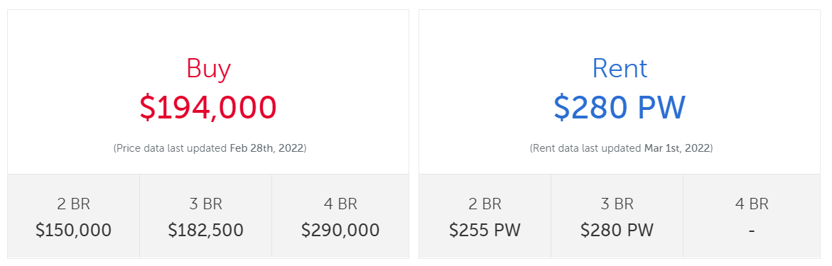
4. Affordability (price of living)
Northam
Narrogin

Slide 10
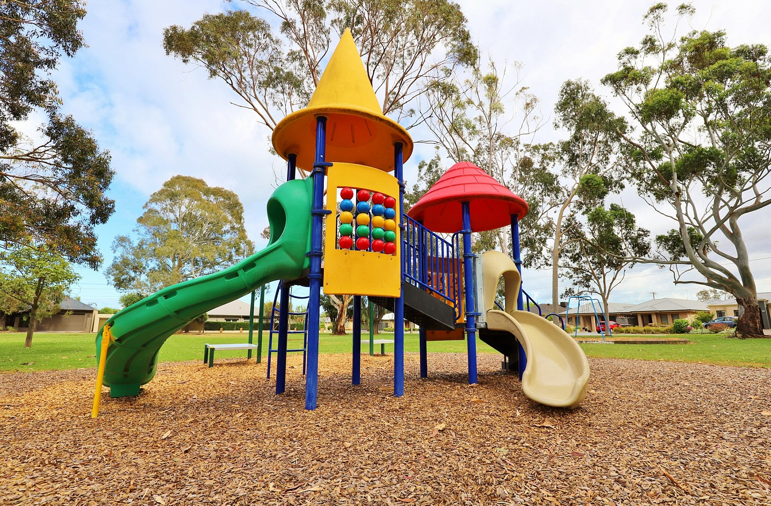
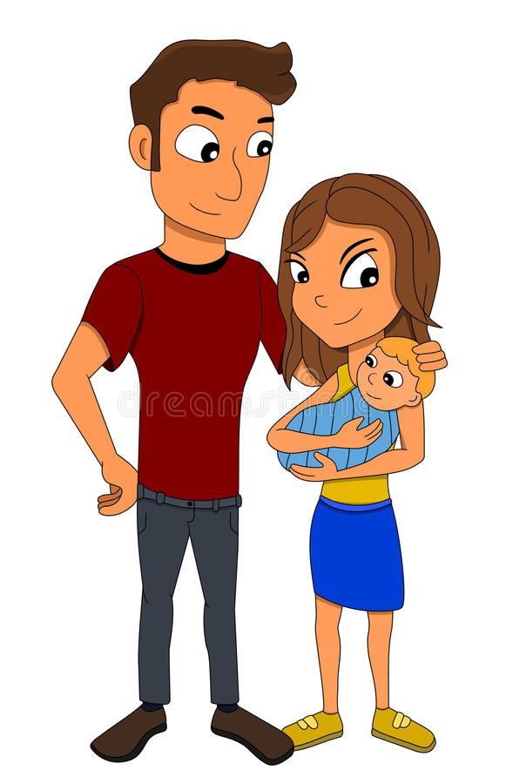

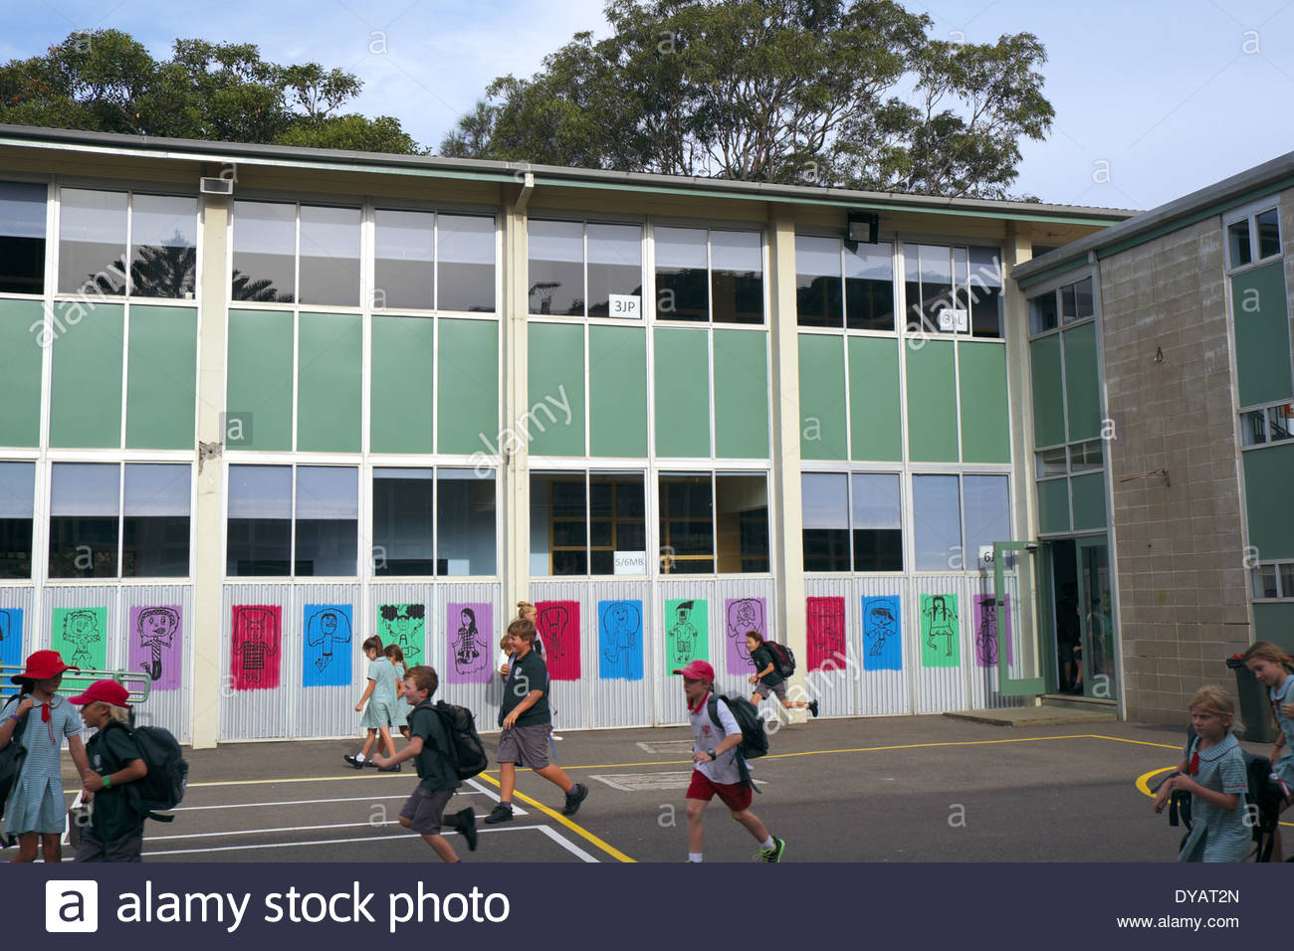

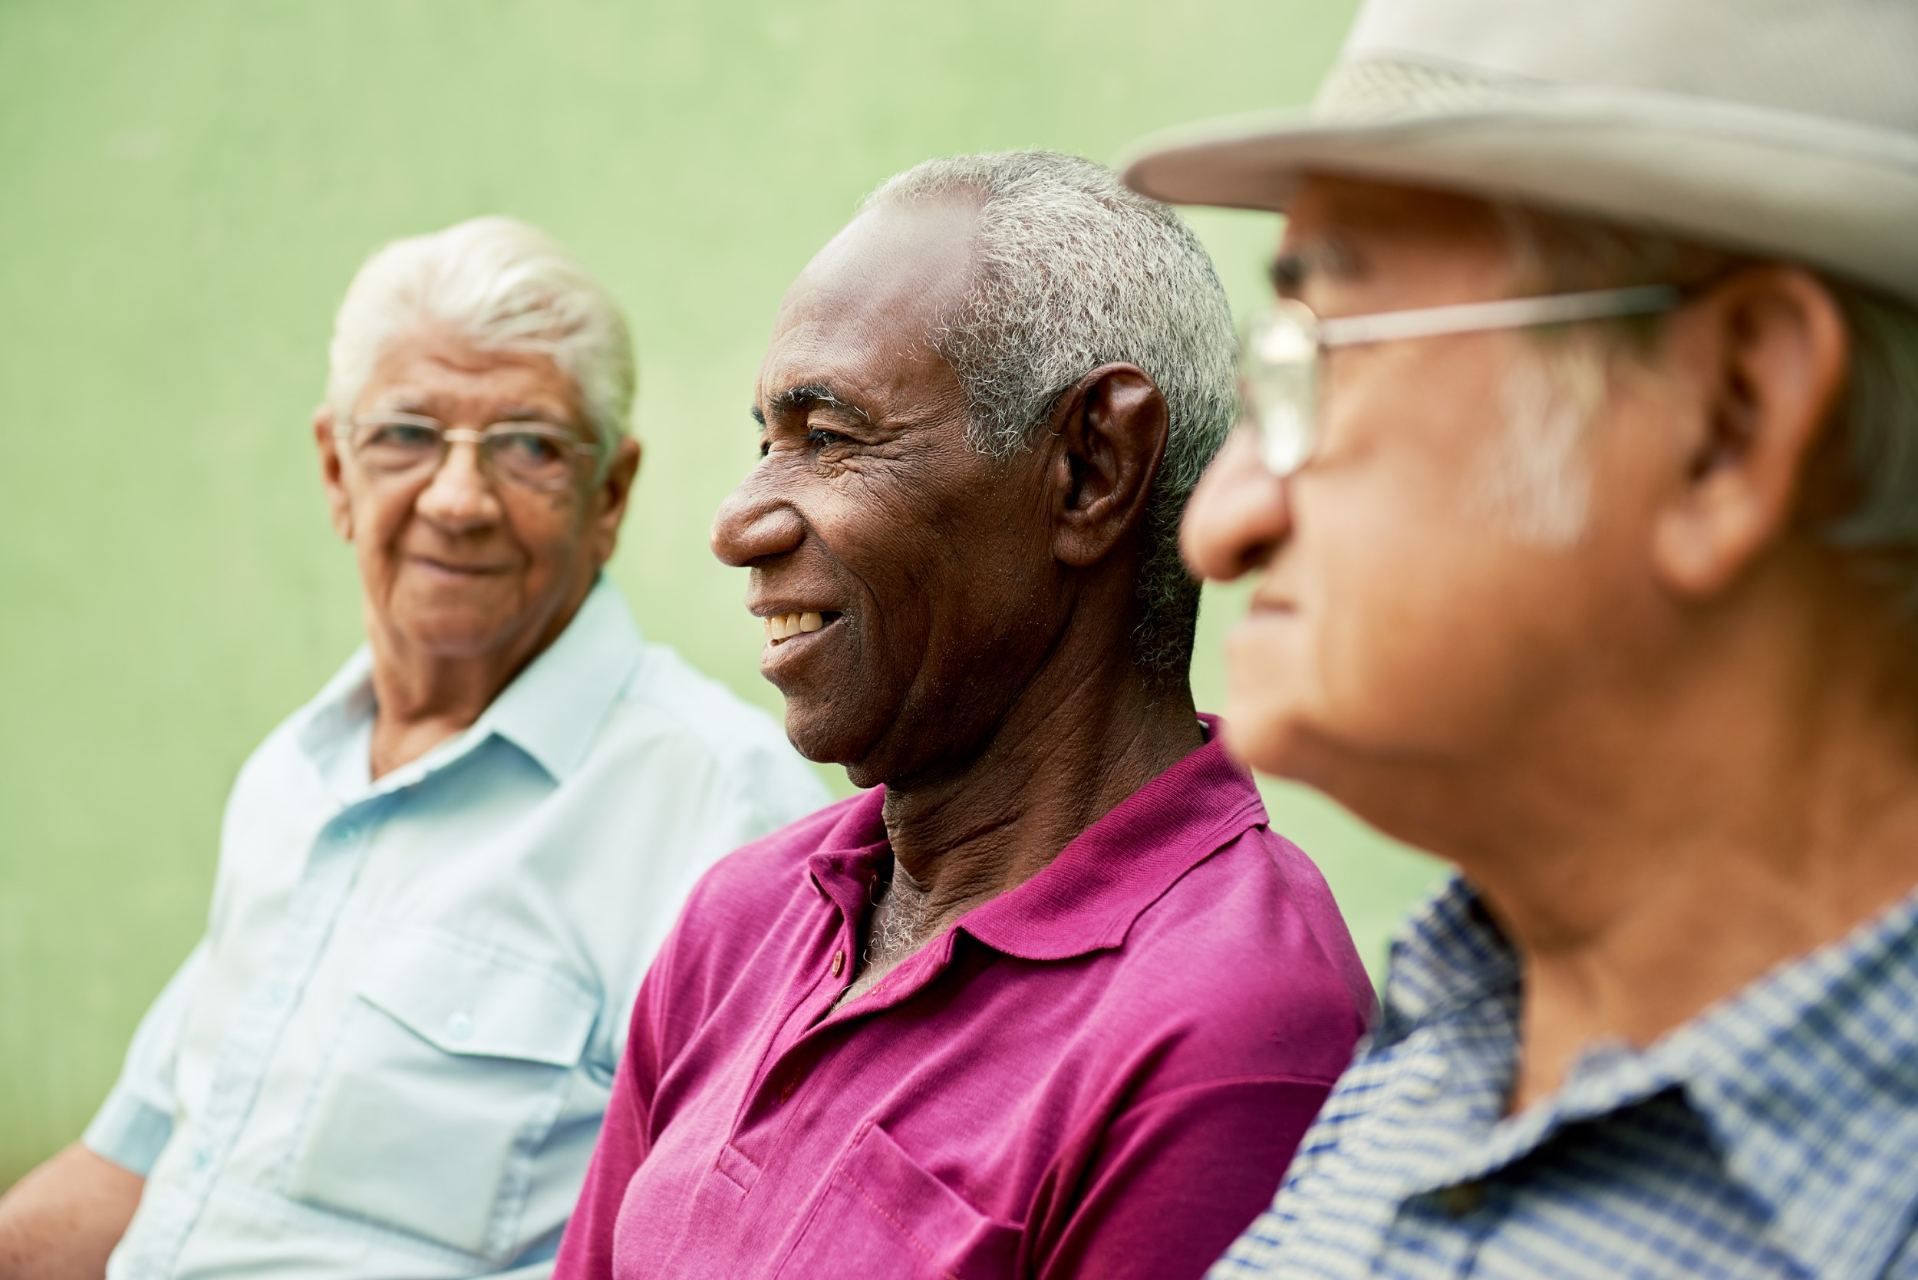

5. Stage of life

Slide 11
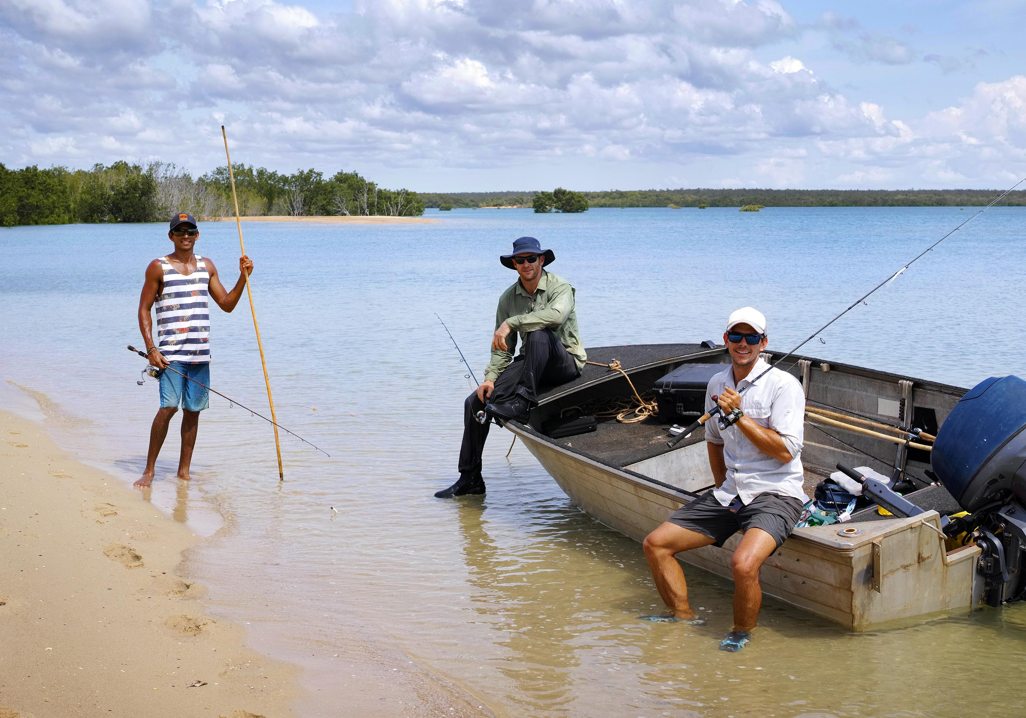

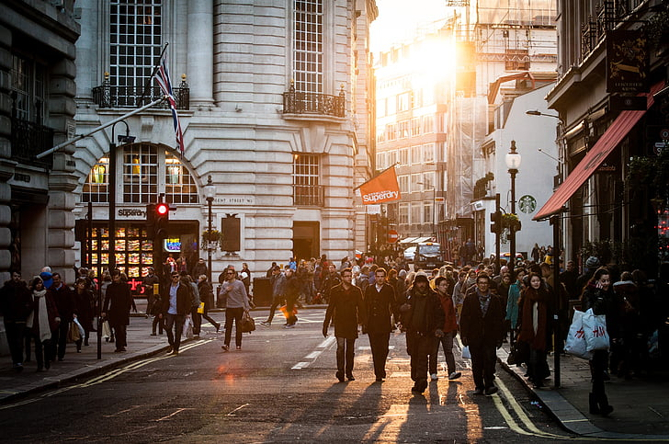
6. Lifestyle

Slide 12
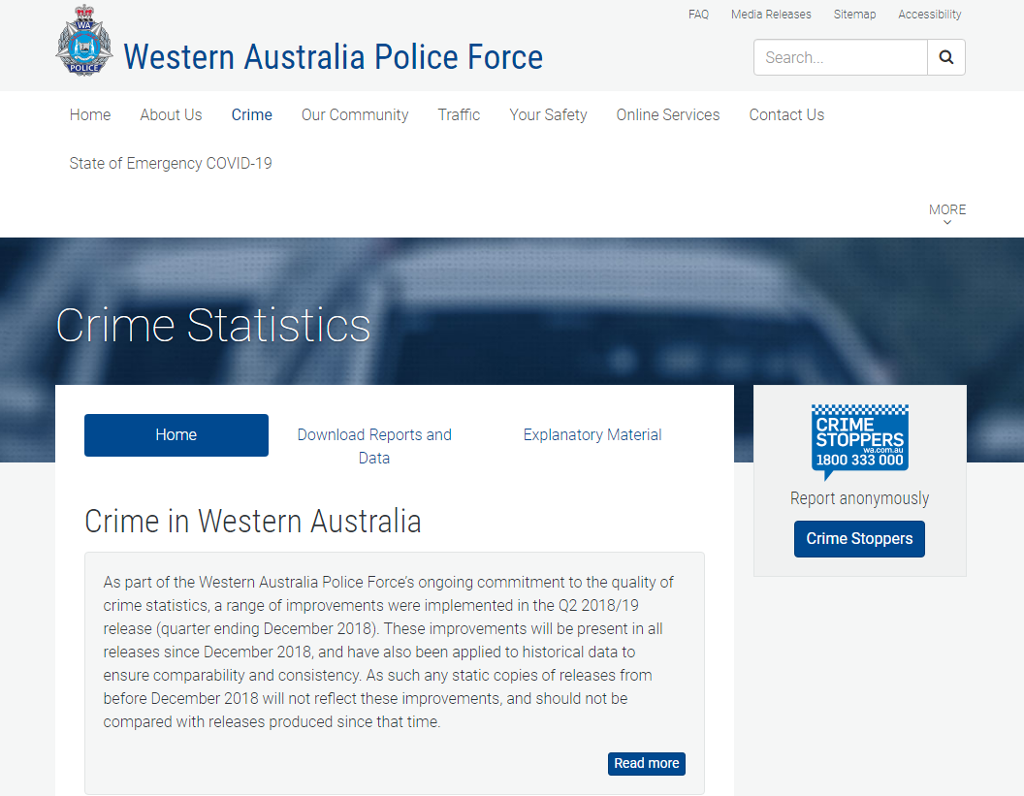
7. Personal safety
https://www.police.wa.gov.au/Crime/CrimeStatistics#/

Slide 13
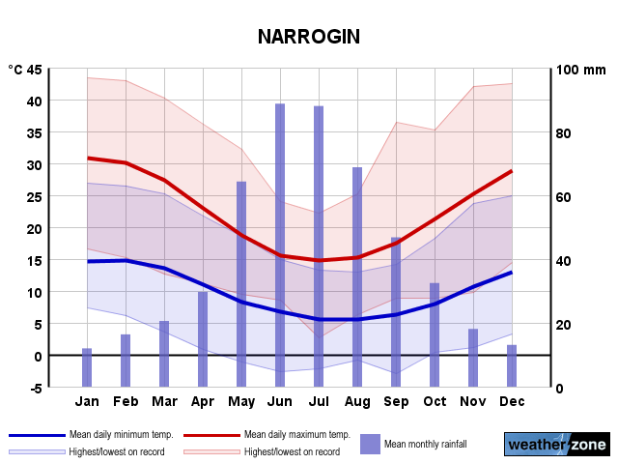

8. Environmental Factors (e.g. Climate)

Slide 14
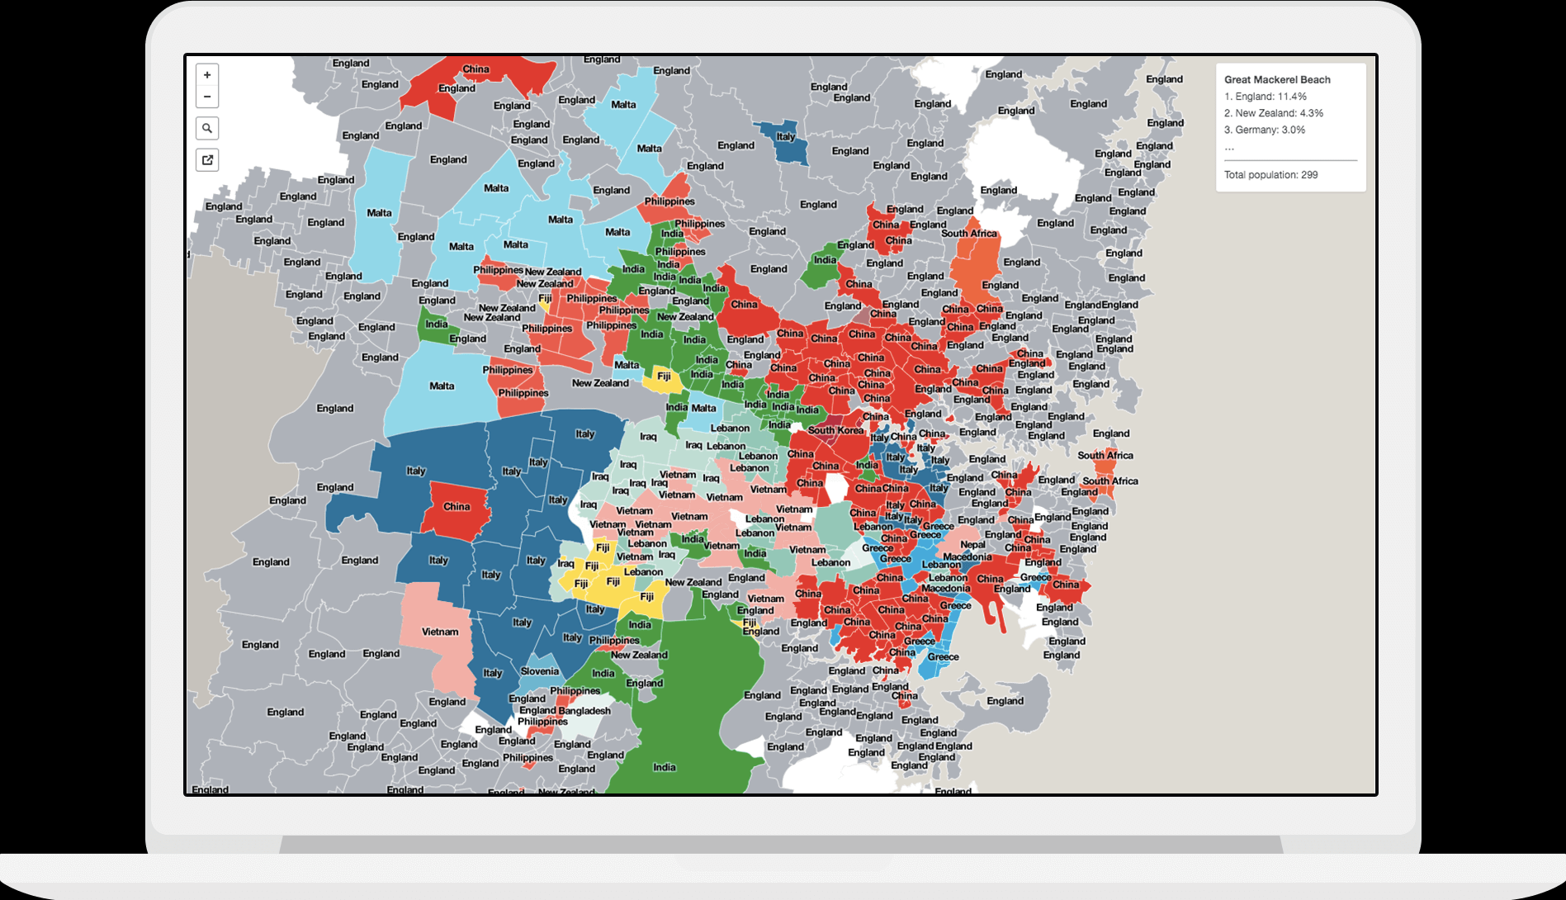
9. Culture and ethnicity
https://smallmultiples.com.au/projects/mapping-immigrants-birth-places/

Slide 15
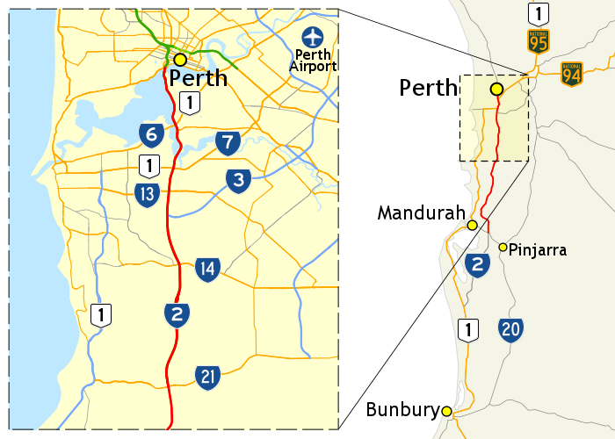
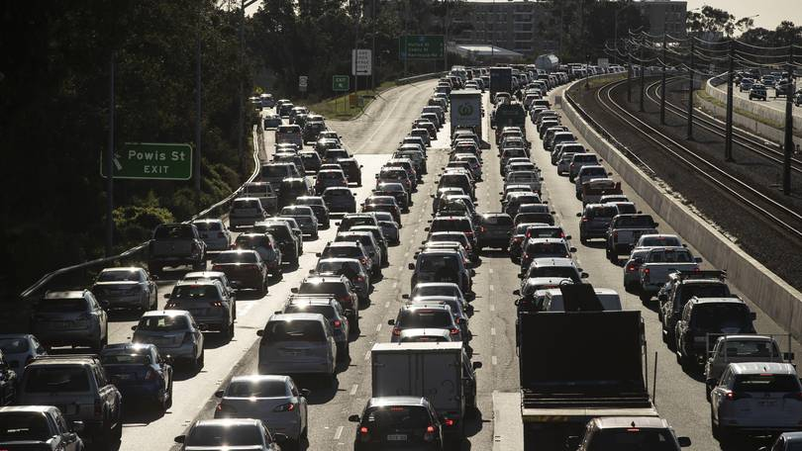
10. Travel time and transport options

Slide 16
Application of learning
Image analysis

